Slide 2
DNA for sequencing
06

Slide 3
Teacher notes: Session contents
Explaining gel electrophoresis | 10 min | Explanation of how gel electrophoresis can be used to find the size of DNA bands by comparison to a DNA ladder.
Performing gel electrophoresis | 35 min | Following the experimental procedures for preparing a sample, loading and running the gel electrophoresis.
Preparing for DNA sequencing | 15 min | Interpreting the results of gel electrophoresis and preparing samples to send off for DNA sequencing.

Slide 4
DNA for sequencing
Explaining gel electrophoresis
Performing gel electrophoresis
Preparing for DNA sequencing

Slide 5
Explaining gel electrophoresis
If the DNA extraction and PCR have been successful, the size of the amplicon (amplified DNA barcode using PCR) should be about 710 bp (base pairs).
Cytochrome c oxidase subunit 1 gene
5’
3’
Amplicon: 710 bp DNA barcode amplified by PCR
primer
DNA strands
3’
5’
NOTE: This image is not to scale!
Notes:
NOTE: this diagram is NOT to scale!
The ends of the strands that make up the DNA molecule are given names relating to whether they finish with the phosphate group attached to carbon 5 of the deoxyribose sugar (the 5’ end) or whether they finish with the place where a phosphodiester bond would form with carbon 3 of the deoxyribose sugar. This helps us to tell which way round the DNA molecule is.

Slide 6
Explaining gel electrophoresis
The primary factor affecting movement through an agarose gel by electrophoresis is size.
Direction of electrical current
Agarose gel
Well containing biomolecules
Notes:
Which coloured molecule is the smallest? Red
Which coloured molecule is the largest? Blue
Which coloured molecule went the furthest? Red
Which coloured molecule went least distance? Blue

Slide 7
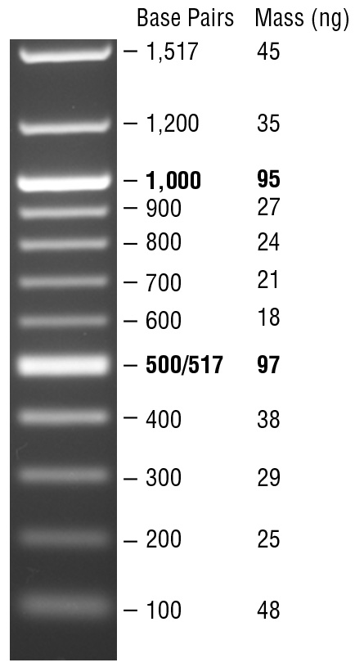
Explaining gel electrophoresis
100 bp ladder
Gel electrophoresis is used to compare DNA from the PCR with bands of known size, to see whether a band of the expected size (710 bp) has been produced.
The bands of known size are also called a DNA ladder, as they look like a ladder on a gel after electrophoresis We use a DNA ladder that has band sizes of: 100 bp, 200 bp, 300 bp, 400 bp, 500 bp, 600 bp, 700 bp, 800 bp, 900 bp, 1000 bp, 1200 bp, 1517 bp.
Credit: New England Biolabs
Notes:
Image from NEB website of 100 bp ladder
Note: bp = base pairs

Slide 8
Explaining gel electrophoresis
Gels can be used to compare size of the PCR product to a DNA ladder, with bands of known sizes.
1517 bp
1200 bp
1000 bp
900 bp
800 bp
700 bp
600 bp
500 bp
400 bp
300 bp
200 bp
100 bp
DNA ladder
Expected PCR product
No PCR product
Some PCR product
Notes:
Note that there are 4 wells in this representation.
The band at about 710 bp is the expected size of DNA product.
Sometimes there is a weak / fuzzy band at about 100 bp. This is a ‘primer dimer’ – an artefact produced by primers overlapping each other and amplifying themselves.

Slide 9
DNA for sequencing
Explaining gel electrophoresis
Performing gel electrophoresis
Preparing for DNA sequencing

Slide 10
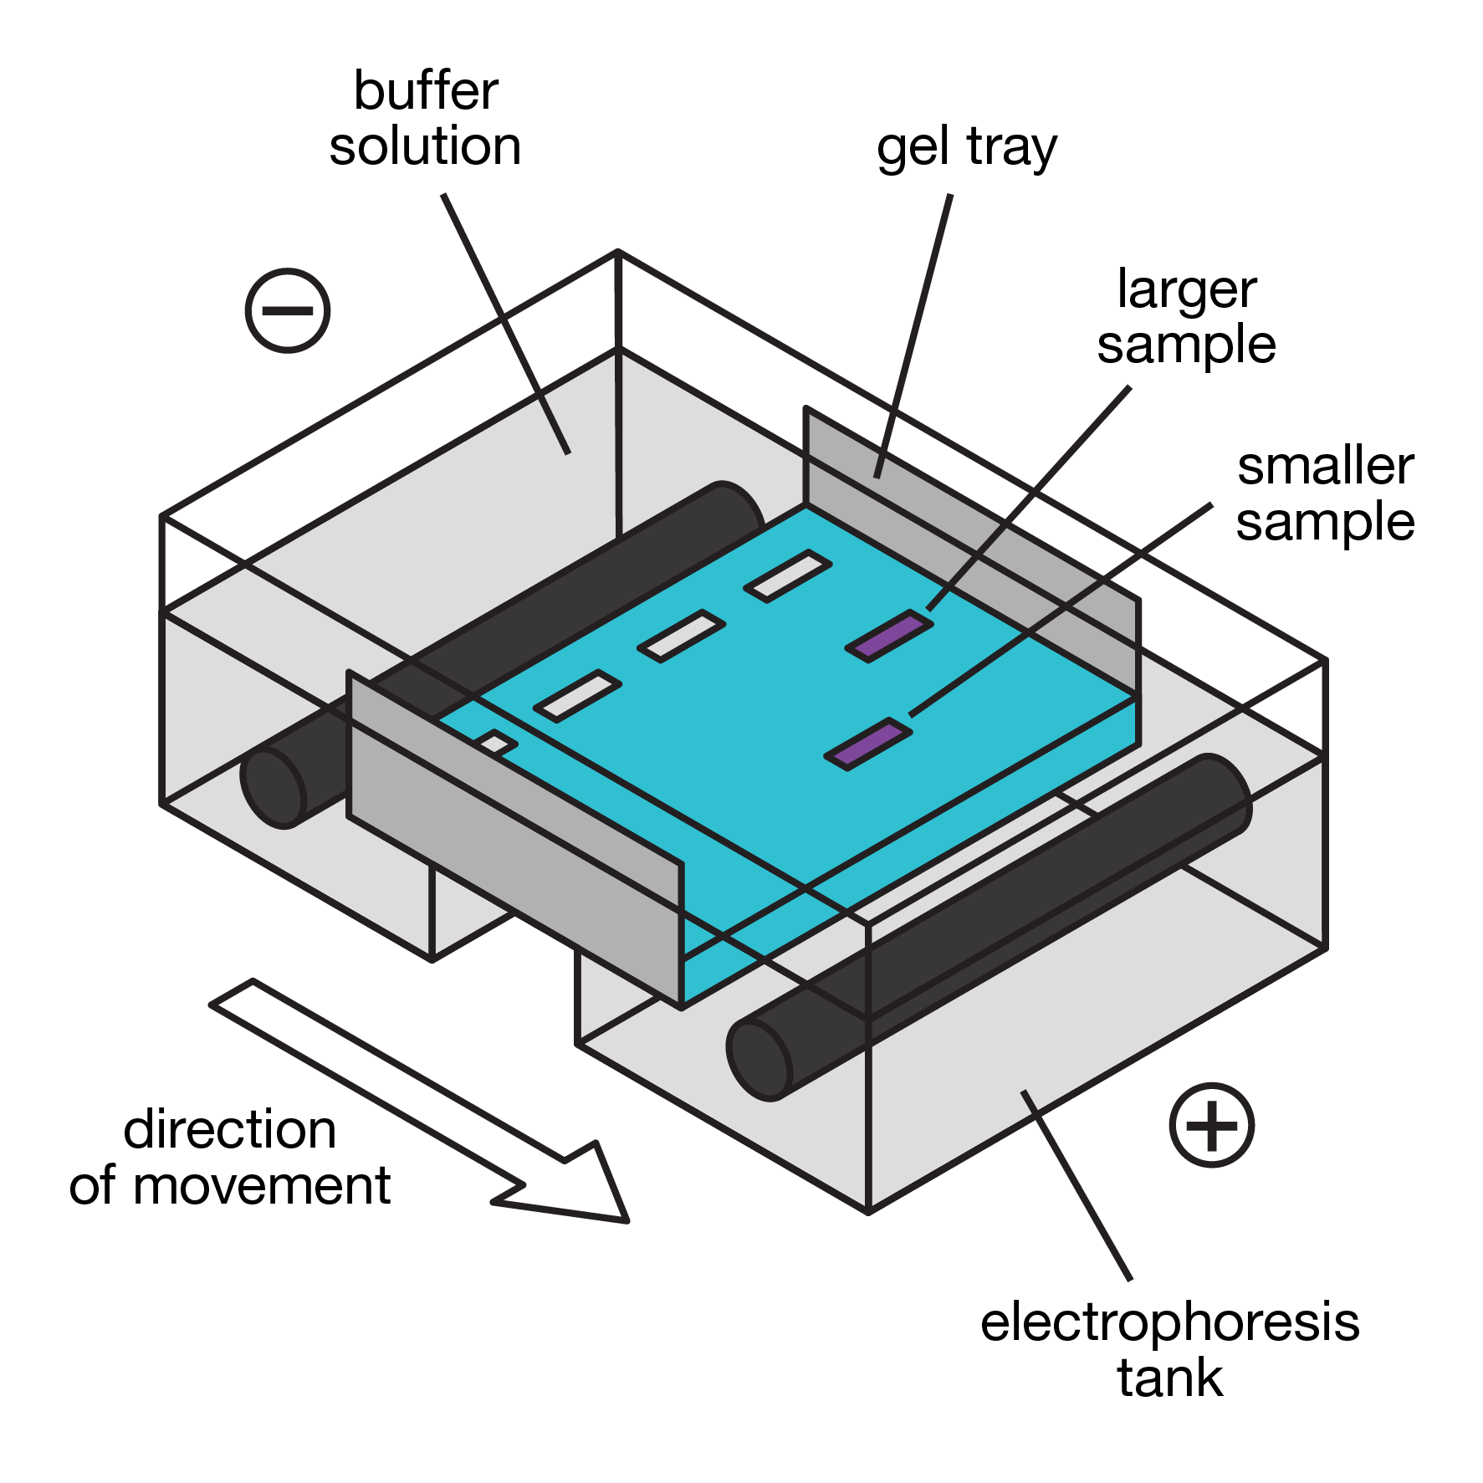

Performing gel electrophoresis
Before performing electrophoresis, you should put on gloves and safety glasses.
Prepare the PCR product for loading onto the agarose gel following the experimental procedure.
* Pipette the reaction up and down 3 or 4 times to mix, so the GelGreen® DNA stain does not settle.

Slide 11
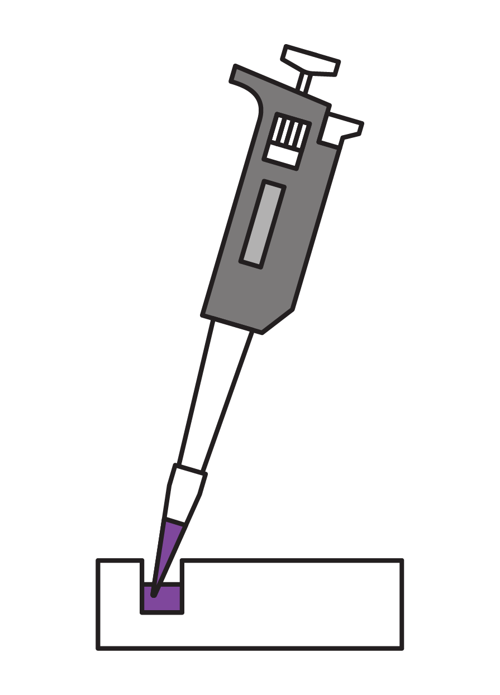
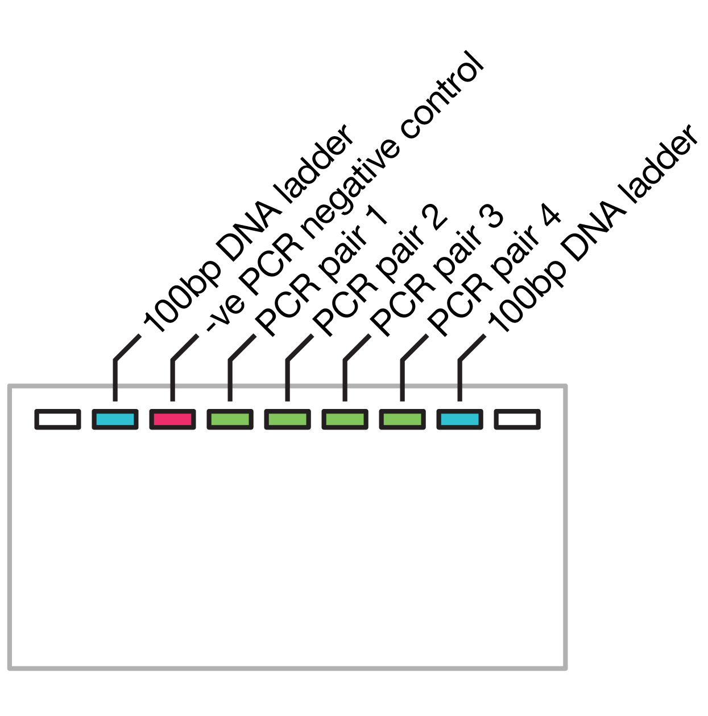
Performing gel electrophoresis
Before performing electrophoresis, you should put on gloves and safety glasses.
Load 10 µl of prepared mixtures into a well, following the instructions
* Don’t put the tip into the well, the samples have greater density than the buffer, so will sink into the well
When the gel is loaded, place the orange lid on and press the power button to start electrophoresis
Start a timer for 20 minutes

Slide 12
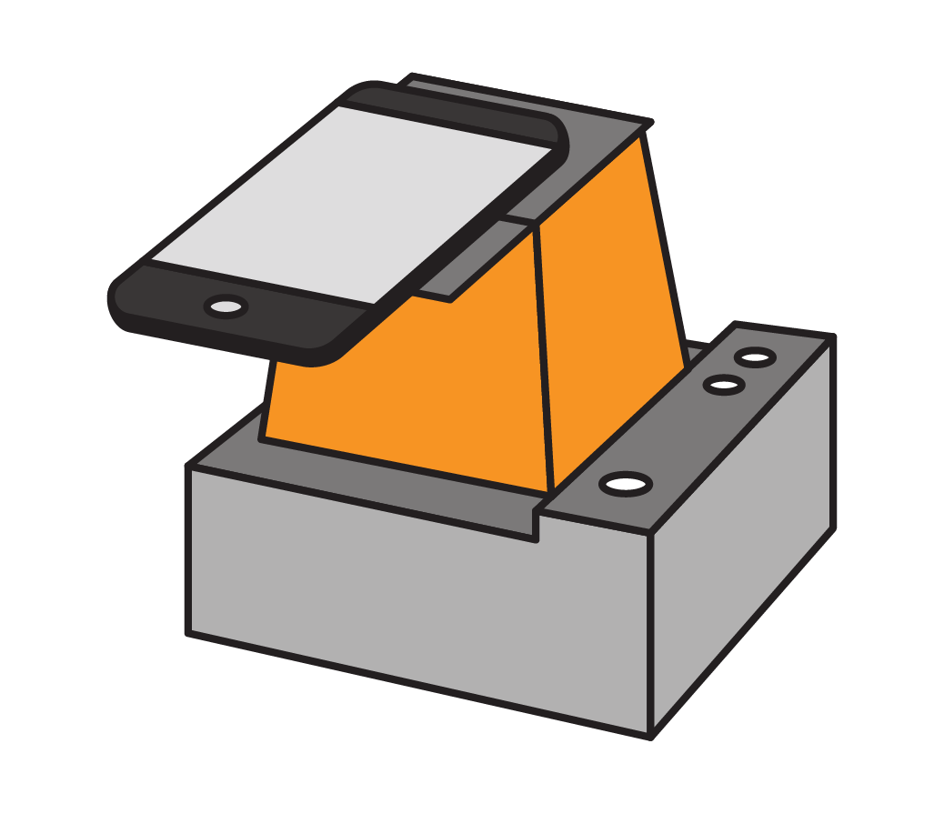
Performing gel electrophoresis
When 20 minutes have passed, unplug the electrophoresis tank at the socket
Turn on the blue light and observe the gel through the window in the orange filter
Place a smart device camera or digital camera lens, directly on the photo hood top
Focus on the DNA bands in the gel, then take a photo

Slide 13
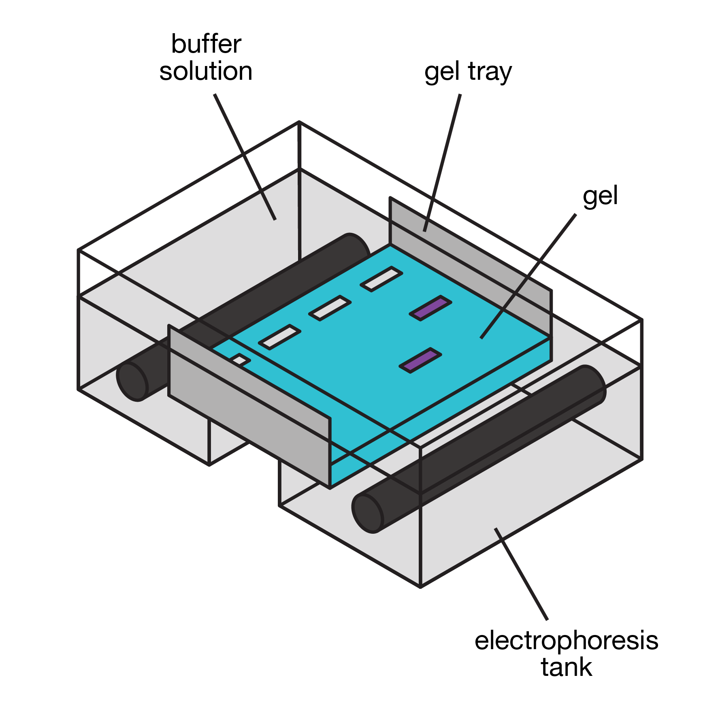
Performing gel electrophoresis
One person for each tank should put on gloves and safety glasses again.
This person should carefully lift the gel out of the buffer and place it into the autoclave bag
The person in gloves and safety glasses should then empty the buffer from the gel carriage into the sink, rinsing it with plenty of water.

Slide 14
DNA for sequencing
Explaining gel electrophoresis
Performing gel electrophoresis
Preparing for DNA sequencing

Slide 15
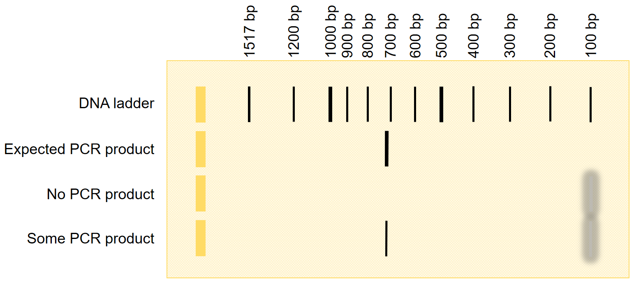
Preparing for DNA sequencing
If you have a band visible on your gel at about 710 bp after gel electrophoresis, you have sufficient DNA present for sequencing.
Notes:
Note there are 4 wells in this representation.
The band at about 710 bp is the expected size of DNA product.
Sometimes there is a weak / fuzzy band at about 100 bp. This is a ‘primer dimer’ – an artefact produced by primers overlapping each other and amplifying themselves.

Slide 16
Preparing for DNA sequencing
One person for each sample should put on gloves and safety glasses again.
This person should label a clean microfuge tube with the 7 letter code from the sample record sheet then transfer 20 µl of PCR product into this tube.
Store the labelled tubes containing the student samples in the Isofreeze box at 4°C (in the fridge), until you are ready to deliver them to the Wellcome Sanger Institute for DNA sequencing.

Slide 17

Preparing for DNA sequencing
An overview of the stages of Sanger sequencing using capillary gel electrophoresis:
DNA is denatured and a primer anneals to the DNA (just like in PCR)

Slide 18
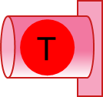
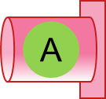
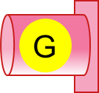
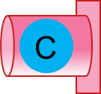
Preparing for DNA sequencing
An overview of the stages of Sanger sequencing using capillary gel electrophoresis:
DNA is denatured and a primer anneals to the DNA (just like in PCR)
DNA polymerase extends the region of double-stranded DNA (just like in PCR) until a fluorescent terminator nucleotide is added
Single-stranded DNA for sequencing
Fluorescent terminator nucleotides
Nucleotides
DNA polymerase
Primer

Slide 19
Preparing for DNA sequencing
An overview of the stages of Sanger sequencing using capillary gel electrophoresis:
DNA is denatured and a primer anneals to the DNA (just like in PCR)
DNA polymerase extends the region of double-stranded DNA (just like in PCR) until a fluorescent terminator nucleotide is added

Slide 20
Preparing for DNA sequencing
An overview of the stages of Sanger sequencing using capillary gel electrophoresis:
DNA is denatured and a primer anneals to the DNA (just like in PCR)
DNA polymerase extends the region of double-stranded DNA (just like in PCR) until a fluorescent terminator nucleotide is added

Slide 21
Preparing for DNA sequencing
An overview of the stages of Sanger sequencing using capillary gel electrophoresis:
DNA is denatured and a primer anneals to the DNA (just like in PCR)
DNA polymerase extends the region of double-stranded DNA (just like in PCR) until a fluorescent terminator nucleotide is added

Slide 22
Preparing for DNA sequencing
An overview of the stages of Sanger sequencing using capillary gel electrophoresis:
DNA is denatured and a primer anneals to the DNA (just like in PCR)
DNA polymerase extends the region of double-stranded DNA (just like in PCR) until a fluorescent terminator nucleotide is added

Slide 23
Preparing for DNA sequencing
An overview of the stages of Sanger sequencing using capillary gel electrophoresis:
DNA is denatured and a primer anneals to the DNA (just like in PCR)
DNA polymerase extends the region of double-stranded DNA (just like in PCR) until a fluorescent terminator nucleotide is added

Slide 24
Preparing for DNA sequencing
An overview of the stages of Sanger sequencing using capillary gel electrophoresis:
DNA is denatured and a primer anneals to the DNA (just like in PCR)
DNA polymerase extends the region of double-stranded DNA (just like in PCR) until a fluorescent terminator nucleotide is added
This produces fragments of a range of sizes, which can be separated through gel in a narrow capillary by electrophoresis

Slide 25
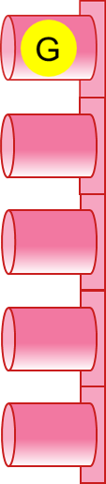

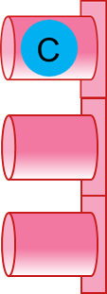

Preparing for DNA sequencing
Laser
An overview of the stages of Sanger sequencing using capillary gel electrophoresis:
DNA is denatured and a primer anneals to the DNA (just like in PCR)
DNA polymerase extends the region of double-stranded DNA (just like in PCR) until a fluorescent terminator nucleotide is added
This produces fragments of a range of sizes, which can be separated through gel in a narrow capillary by electrophoresis
As fragments migrate a laser excites the fluorescent terminator base and a detector records the colour on a chromatogram.
Capillary containing gel
Detector
Chromatogram
Fluorescence detected
Time

Slide 26
Preparing for DNA sequencing
Laser
An overview of the stages of Sanger sequencing using capillary gel electrophoresis:
DNA is denatured and a primer anneals to the DNA (just like in PCR)
DNA polymerase extends the region of double-stranded DNA (just like in PCR) until a fluorescent terminator nucleotide is added
This produces fragments of a range of sizes, which can be separated through gel in a narrow capillary by electrophoresis
As fragments migrate a laser excites the fluorescent terminator base and a detector records the colour on a chromatogram.
Capillary containing gel
Detector
Chromatogram
Fluorescence detected
T
Time

Slide 27
Preparing for DNA sequencing
Laser
An overview of the stages of Sanger sequencing using capillary gel electrophoresis:
DNA is denatured and a primer anneals to the DNA (just like in PCR)
DNA polymerase extends the region of double-stranded DNA (just like in PCR) until a fluorescent terminator nucleotide is added
This produces fragments of a range of sizes, which can be separated through gel in a narrow capillary by electrophoresis
As fragments migrate a laser excites the fluorescent terminator base and a detector records the colour on a chromatogram.
Capillary containing gel
Detector
Chromatogram
Fluorescence detected
T
T
Time

Slide 28
Preparing for DNA sequencing
Laser
An overview of the stages of Sanger sequencing using capillary gel electrophoresis:
DNA is denatured and a primer anneals to the DNA (just like in PCR)
DNA polymerase extends the region of double-stranded DNA (just like in PCR) until a fluorescent terminator nucleotide is added
This produces fragments of a range of sizes, which can be separated through gel in a narrow capillary by electrophoresis
As fragments migrate a laser excites the fluorescent terminator base and a detector records the colour on a chromatogram.
Capillary containing gel
Detector
Chromatogram
Fluorescence detected
T
T
C
Time

Slide 29
Preparing for DNA sequencing
Laser
An overview of the stages of Sanger sequencing using capillary gel electrophoresis:
DNA is denatured and a primer anneals to the DNA (just like in PCR)
DNA polymerase extends the region of double-stranded DNA (just like in PCR) until a fluorescent terminator nucleotide is added
This produces fragments of a range of sizes, which can be separated through gel in a narrow capillary by electrophoresis
As fragments migrate a laser excites the fluorescent terminator base and a detector records the colour on a chromatogram.
Capillary containing gel
Detector
Chromatogram
Fluorescence detected
T
T
C
A
Time

Slide 30
Preparing for DNA sequencing
Laser
An overview of the stages of Sanger sequencing using capillary gel electrophoresis:
DNA is denatured and a primer anneals to the DNA (just like in PCR)
DNA polymerase extends the region of double-stranded DNA (just like in PCR) until a fluorescent terminator nucleotide is added
This produces fragments of a range of sizes, which can be separated through gel in a narrow capillary by electrophoresis
As fragments migrate a laser excites the fluorescent terminator base and a detector records the colour on a chromatogram.
Capillary containing gel
Detector
Chromatogram
Fluorescence detected
T
T
C
A
G
Time

Slide 31
Preparing for DNA sequencing
After Sanger sequencing using capillary gel electrophoresis a chromatogram and a FASTA file will be produced.
Chromatogram
Fluorescence detected
T
T
C
A
G
Time
>Sequence name
TTCAGGTACAGGATACAATAGACTTAGACATAGGCATAGCACCCAGATAGGCGGCTGCAATGCATACAGCCCCGAGGGGTTACA

Slide 32
DNA for sequencing
Explaining gel electrophoresis
Performing gel electrophoresis
Preparing for DNA sequencing
Next session we be visiting the Wellcome Sanger Institute, taking our DNA samples for sequencing.

Slide 33
Thank you
Barcoding for beginners is a project by Wellcome Connecting Science, funded by a Royal Society Partnership grant.
All resources can be found on YourGenome: yourgenome.org/theme/barcoding-for-beginners
Image credits Wellcome Connecting Science

